Slide 1
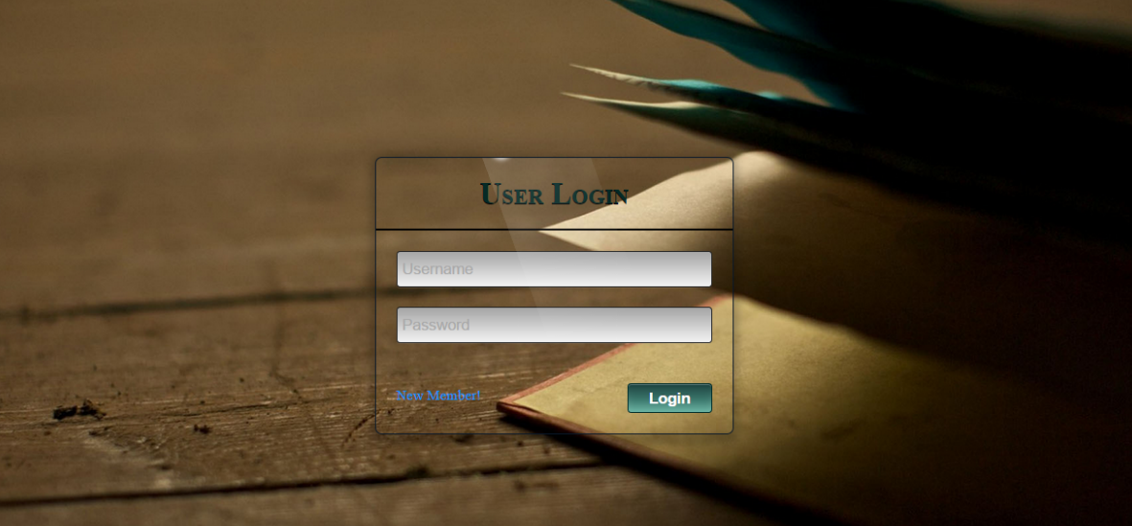
FIRST LOOK- LOGIN PAGE

Slide 2
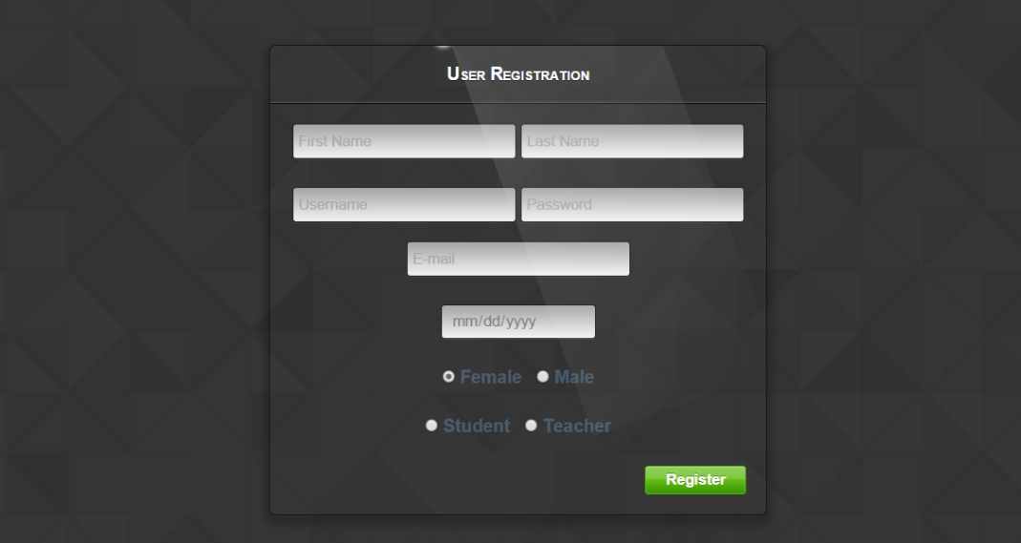
FIRST LOOK- RGISTRATION PAGE

Slide 3
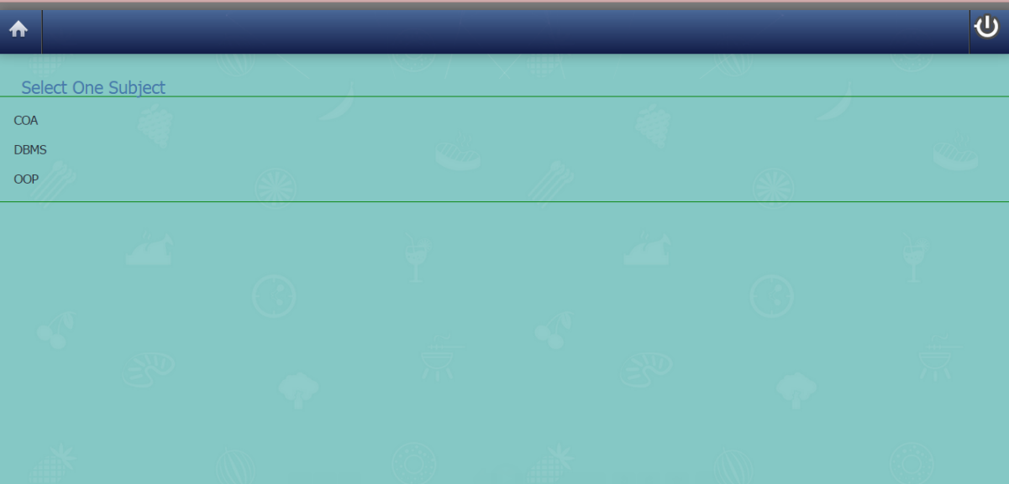
FIRST LOOK- AFTER LOGIN

Slide 4
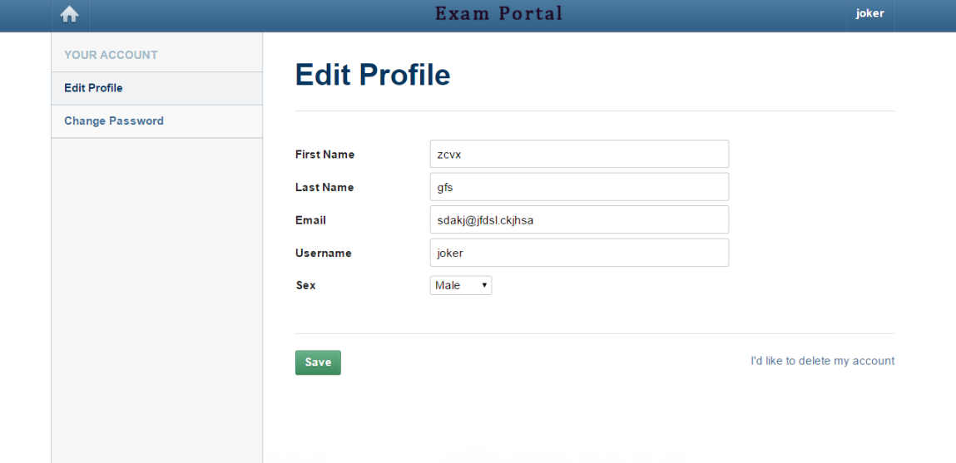
FIRST LOOK- EDIT PROFILE

Slide 5

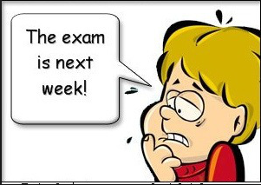

ADDITIONAL FUNTIONALITIES
TEACHER-STUDENT DISCUSSION FORUM
RANDOM QUESTIONS GENERATION
SET TIME TO EACH QUESTION
EXAM TIME IS QUESTION DEPENDENT
FEEDBACK FORM

Slide 6
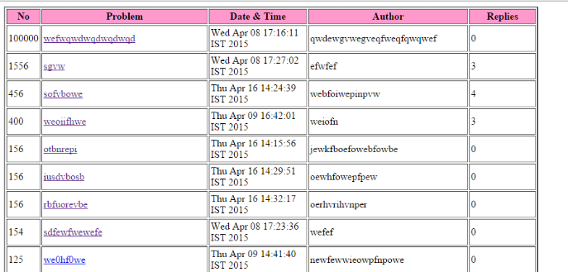
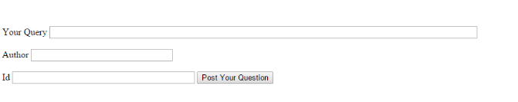
DISCUSSION FORUM- QUESTION

Slide 7
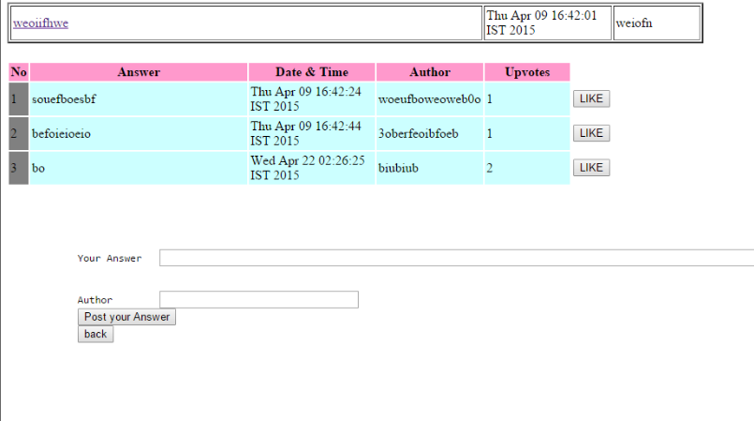
DISCUSSION FORUM- ANSWER
LIKE PLEASE

Slide 8

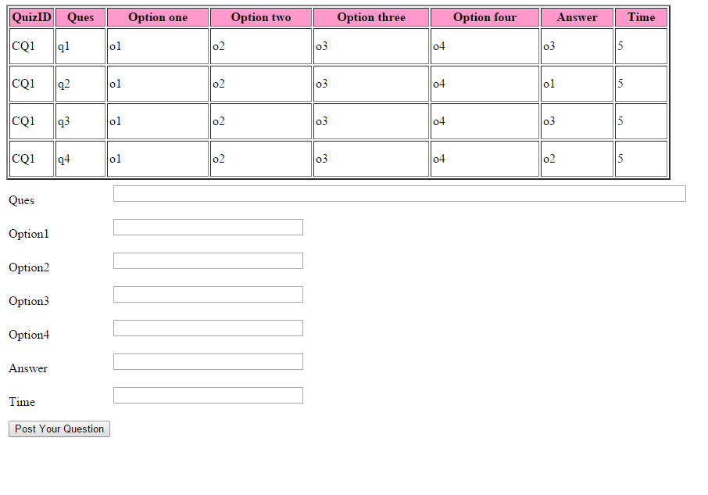
CREATE QUIZ QUESTIONS

Slide 9
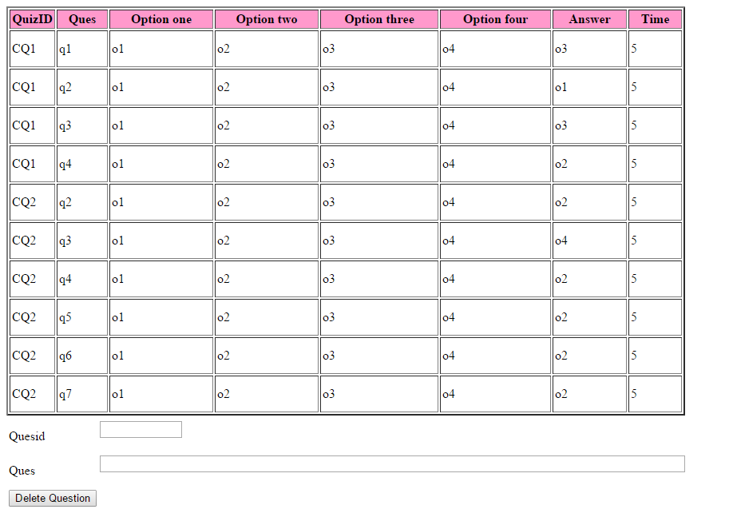
DELETE QUIZ QUESTIONS

Slide 10

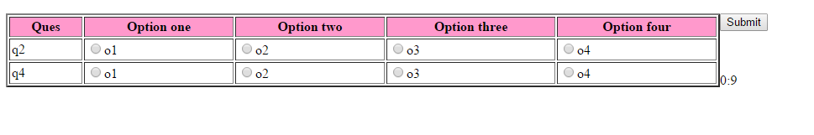
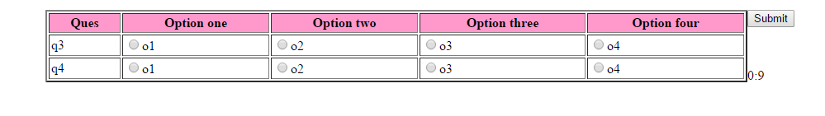
OPT QUIZ
RANDOM QUES
TIMER

Slide 11
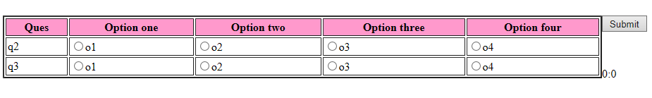
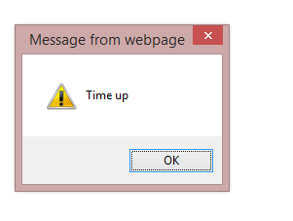
OPT QUIZ- TIMES UP
QUIZ OVER !!!

Slide 12

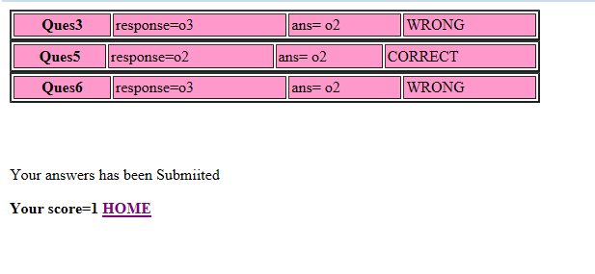
AFTER SUBMIT PAGE
OR

Slide 13
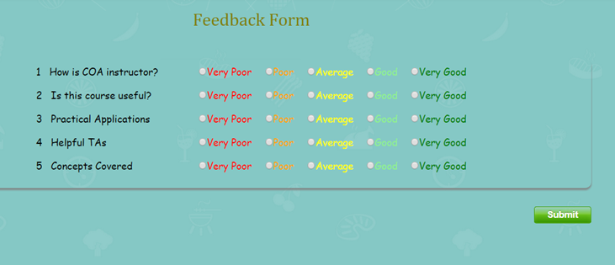
FEEDBACK FORM- RATING
RATE YOUR COURSE

Slide 14
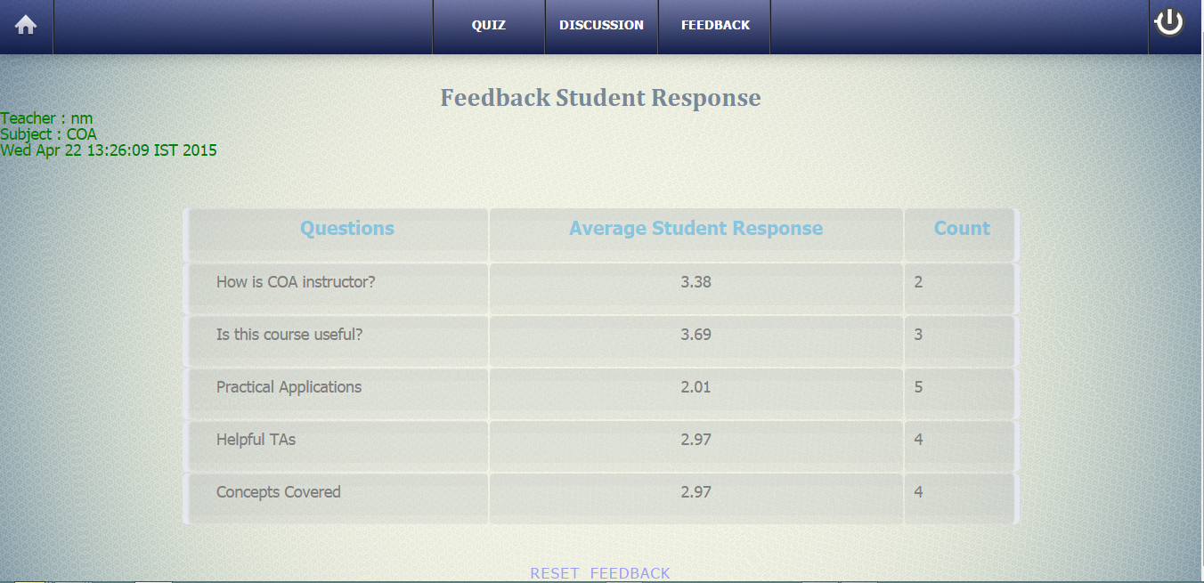
FEEDBACK OUTCOMES

Slide 15
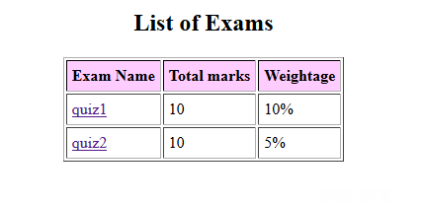
VIEW RESULTS

Slide 16

THANKS

